Slide 1
Distributed Control and Automation Framework (DCAF)
Static Modules
Benjamin Celis, Mathew Pollock, Simon Perez

Slide 2
Agenda
What is a Static Module
When to create a Static module
Common Overrides
Exercise Module
Recruiting Modules ( ? )

Slide 3
What are Static Modules?

Slide 4
Static Module
What information needs to be configurable?
Application specific modules will have a number of inputs and outputs that do not change.
Therefore, use the Static Module Template

Slide 5
Static Module
Template included with DCAF
Theoretically there is no underlying difference
Do not need to create the User Interface for the configuration
Only need to write the actual logic in specific User Override methods
[image of a project with vi’s highlighted]

Slide 6
When to create Static Modules?

Slide 7
Static Module
Static Number of Inputs and Outputs
Common for Processing Modules
Common for fixed application-specific logic

Slide 8
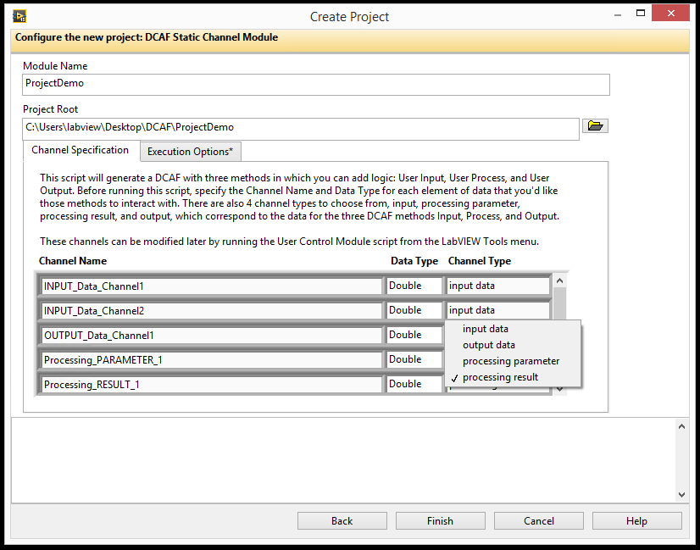
Creating a Static Module
Create Project through Template
Creates 3 main classes:
ModuleName configuration.lvlclass
ModuleName editor.lvlclass
ModuleName runtime.lvlclass

Slide 9
Static Module Checklist
Create the Module from the Static Module Sample Project
Define the Channels
Add Parameters to set desired keys.vi (optional)
Handle initialization (optional)
Handle initialization of references, sessions, parameters
Pass References into Runtime class if necessary, modify object to allow this
Implement the Input, Processing, and/or Output Methods as needed
Modify user process.vi to contain references or the Runtime class if needed and process.vi to pass data necessary to `user process.vi`
Add Processing code to `user process.vi`
Add code to input.vi to pass necessary sessions or config data to user input.vi
Add input code to `user input.vi`.
Repeat for output
Programming Considerations for Run-State Methods
Determinism
Non-blocking execution
Specifying other properties
Testing and validation
Developer’s Guide Checklist

Slide 10
Static Module Checklist
Create the Module from the Static Module Sample Project
Define the Channels
Add Parameters to set desired keys.vi (optional)
Handle initialization (optional)
Handle initialization of references, sessions, parameters
Pass References into Runtime class if necessary, modify object to allow this
Implement the Input, Processing, and/or Output Methods as needed
Modify user process.vi to contain references or the Runtime class if needed and process.vi to pass data necessary to `user process.vi`
Add Processing code to `user process.vi`
Add code to input.vi to pass necessary sessions or config data to user input.vi
Add input code to `user input.vi`.
Repeat for output
Programming Considerations for Run-State Methods
Determinism
Non-blocking execution
Specifying other properties
Testing and validation
Create the Module from the Template

Slide 11
Static Module Checklist
Create the Module from the Static Module Sample Project
Define the Channels
Add Parameters to set desired keys.vi (optional)
Handle initialization (optional)
Handle initialization of references, sessions, parameters
Pass References into Runtime class if necessary, modify object to allow this
Implement the Input, Processing, and/or Output Methods as needed
Modify user process.vi to contain references or the Runtime class if needed and process.vi to pass data necessary to `user process.vi`
Add Processing code to `user process.vi`
Add code to input.vi to pass necessary sessions or config data to user input.vi
Add input code to `user input.vi`.
Repeat for output
Programming Considerations for Run-State Methods
Determinism
Non-blocking execution
Specifying other properties
Testing and validation
Set up the configuration that can be saved and loaded on initiation
Examples
File Path
Network address
Data encoding
Avoid directly modifying the UI

Slide 12
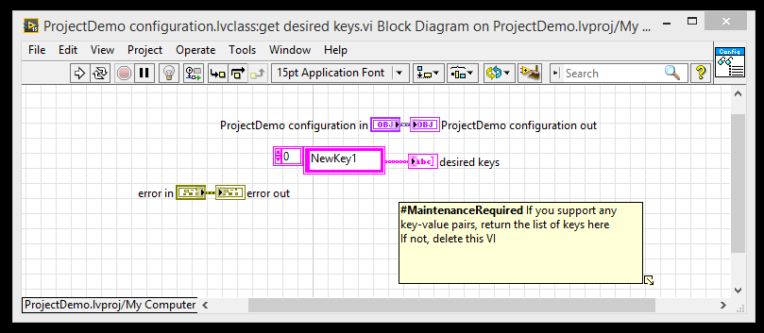
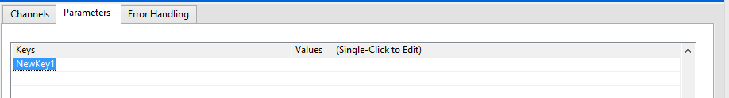
Static Module Checklist
To add a Key Value Pair, modify the get desired keys.vi
Modify the Apply Key Value Pairs.vi to do something with the data

Slide 13
Static Module Checklist
Create the Module from the Static Module Sample Project
Define the Channels
Add Parameters to set desired keys.vi (optional)
Handle initialization (optional)
Handle initialization of references, sessions, parameters
Pass References into Runtime class if necessary, modify object to allow this
Implement the Input, Processing, and/or Output Methods as needed
Modify user process.vi to contain references or the Runtime class if needed and process.vi to pass data necessary to `user process.vi`
Add Processing code to `user process.vi`
Add code to input.vi to pass necessary sessions or config data to user input.vi
Add input code to `user input.vi`.
Repeat for output
Programming Considerations for Run-State Methods
Determinism
Non-blocking execution
Specifying other properties
Testing and validation
Write the Initialization
Requires modification of the user init.vi and maybe of the init.vi

Slide 14
Creating a Static Module
Create the Module from the Static Module Sample Project
Define the Channels
Add Parameters to set desired keys.vi (optional)
Handle initialization (optional)
Handle initialization of references, sessions, parameters
Pass References into Runtime class if necessary, modify object to allow this
Implement the Input, Processing, and/or Output Methods as needed
Modify user process.vi to contain references or the Runtime class if needed and process.vi to pass data necessary to `user process.vi`
Add Processing code to `user process.vi`
Add code to input.vi to pass necessary sessions or config data to user input.vi
Add input code to `user input.vi`.
Repeat for output
Programming Considerations for Run-State Methods
Determinism
Non-blocking execution
Specifying other properties
Testing and validation
Write the Initialization
Requires modification of the user init.vi and maybe of the init.vi

Slide 15
Static Module Checklist
Create the Module from the Static Module Sample Project
Define the Channels
Add Parameters to set desired keys.vi (optional)
Handle initialization (optional)
Handle initialization of references, sessions, parameters
Pass References into Runtime class if necessary, modify object to allow this
Implement the Input, Processing, and/or Output Methods as needed
Modify user process.vi to contain references or the Runtime class if needed and process.vi to pass data necessary to `user process.vi`
Add Processing code to `user process.vi`
Add code to input.vi to pass necessary sessions or config data to user input.vi
Add input code to `user input.vi`.
Repeat for output
Programming Considerations for Run-State Methods
Determinism
Non-blocking execution
Specifying other properties
Testing and validation
If the module requires configuration information, modify the process.vi to pass the runtime.lvclass into the user process.vi

Slide 16
Static Module Checklist
Create the Module from the Static Module Sample Project
Define the Channels
Add Parameters to set desired keys.vi (optional)
Handle initialization (optional)
Handle initialization of references, sessions, parameters
Pass References into Runtime class if necessary, modify object to allow this
Implement the Input, Processing, and/or Output Methods as needed
Modify user process.vi to contain references or the Runtime class if needed and process.vi to pass data necessary to `user process.vi`
Add Processing code to `user process.vi`
Add code to input.vi to pass necessary sessions or config data to user input.vi
Add input code to `user input.vi`.
Repeat for output
Programming Considerations for Run-State Methods
Determinism
Non-blocking execution
Specifying other properties
Testing and validation
Write the Process, Input or Output functionality in the user process.vi, user input.vi or user output.vi

Slide 17
Static Module
Configuration Class:
Select module options (number of instances, allowable targets)
Update validate.vi with validation rules
Update get default error list.vi with default error classifications
Editor Class:
Select module glyph
Runtime
Implement User Input.vi, User Process.vi, and/or User Output.vi with custom logic

Slide 18
Dynamic Module
Configuration Class:
Editor Class:
Runtime

Slide 19
Excercise

